Slide 1

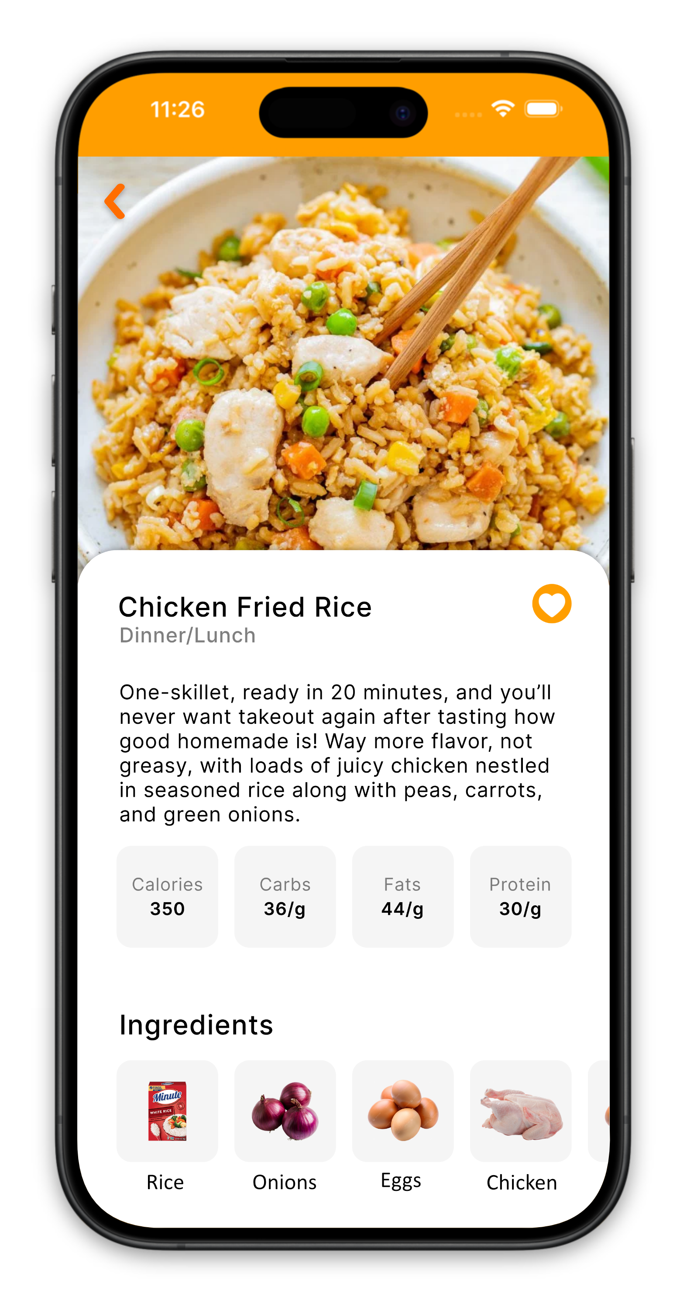
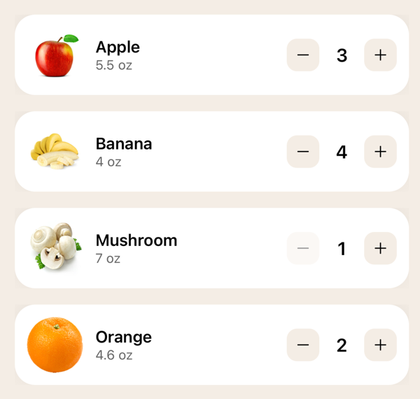
Pantry Chef
Tyler Gilbert, Ashton Hull, Jacob Lehtola, Braxton Wilson
Dept. Of Computer Science and Information Technology
Abstract
Design
Technology
Background
Pantry Chef is a mobile app that helps individuals make better use of the food they already have. The primary purpose of this project is to simplify meal planning by organizing food items and suggesting meals that can be made using only existing ingredients. The app makes adding ingredients easy by letting users scan food barcodes to add them to the pantry or manually add them. Once the ingredients are in the pantry, users can search for recipes they can make using the ingredients they have.
Pantry Chef helps people discover new ways to use the food they have. The app also supports people who are starting their cooking journey by both providing detailed instructions and recipe difficulty ratings. Pantry Chef serves as a practical solution that both encourages resource awareness and supports cooking habits that are both approachable and effective.
Pantry Chef is a mobile app that works on both Apple and Android devices. The app was written in TypeScript, with the UI implemented in React Native. For the app's backend, we used Supabase for both login functionality and for storing ingredients and recipes in the recipe and pantry settings. When designing an app, it is important to consider its appearance, and we wanted to keep a simple, streamlined approach.
One of the main problems we were looking to tackle with Pantry Chef was how to make cooking easier and more accessible for people. As college students, cooking can be a technical nightmare. To help with recipe recommendations, the app keeps track of the ingredients the user already owns and those the user buys in the future. To be as efficient as possible, we combined the two to create an app that not only keeps track of the ingredients you have but also recommends recipes from a database based on the ingredients currently in your pantry.
Figure 2: Users can view the ingredients in their pantry, search and modify existing ingredients.
Pantry Chef is designed with simplicity in mind, as evidenced by its user-friendly interface. The app consists of four main pages: settings, barcode scanner, recipes, and pantry. Every page has a unified purpose: making cooking easier, with a page for keeping track of all ingredients and another page for recipes recommended based on the ingredients in the pantry. To simplify, users can also update information like the quantity of each item added. Scan barcodes of common food items and allow the users to update information based on how many of each item are added.
Figure 3: The app scans barcodes of ingredients to add them into the pantry.
Figure 5: Learn more at get-pantry-chef.com
Figure 1: Pantry Chef supports manufactured and produce ingredients.
References
React Native: reactnative.dev
Spoonacular:spoonacular.com
Supabase: supabase.com
Acknowledgements
We would like to thank Dr. Karen Meisch for her support of students in the College of STEM, and Dr. Leong Lee for his support of students in the Department of CSIT.
Figure 4: The server architecture of Pantry Chef.

